Slide 1
NPR Tile Based Deferred Shader WebGL
Sijie Tian, Yuqin Shao

Slide 2
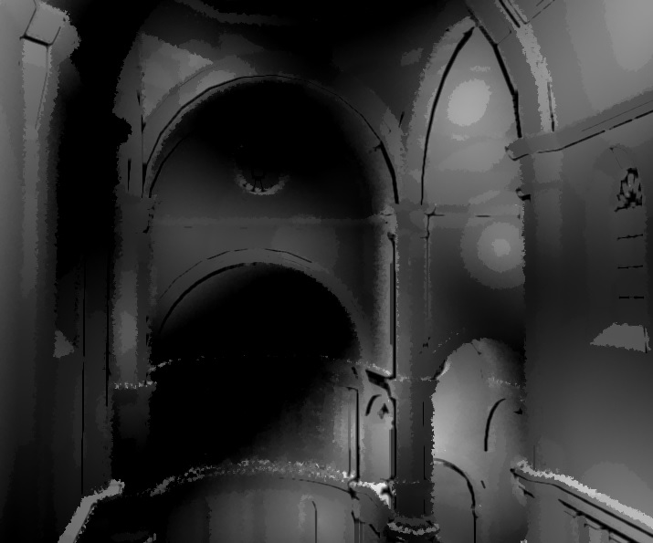
Final Results

Slide 3

Final Results

Slide 4
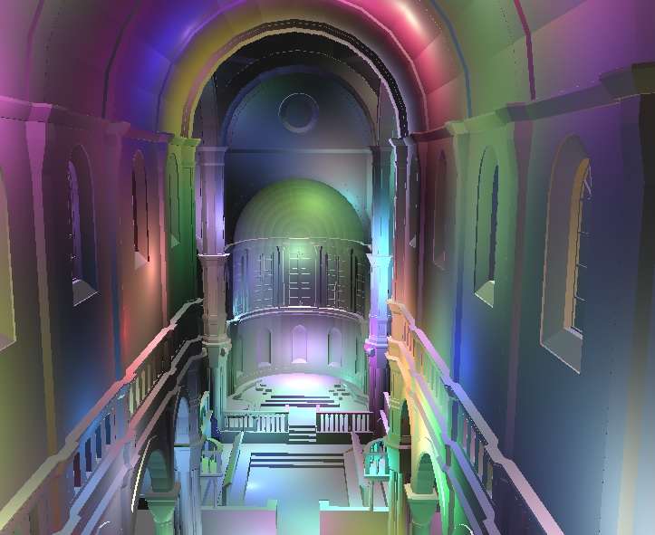
Final Results
Live Demo

Slide 5
Implemented
WebGL Tile Based deferred shading
WebGL Chinese painting effect

Slide 6
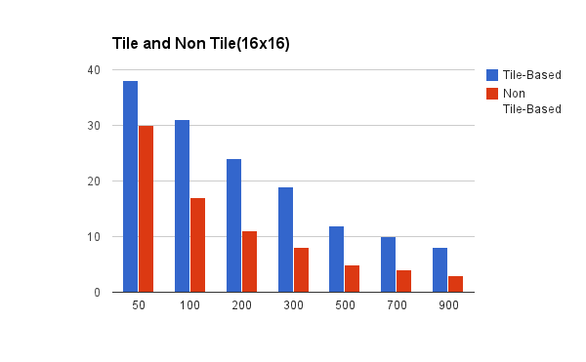
Performance Evaluation

Slide 7
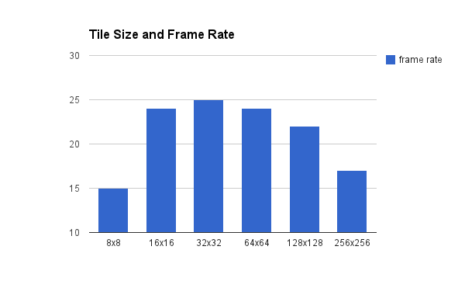
Performance Evaluation

Slide 8
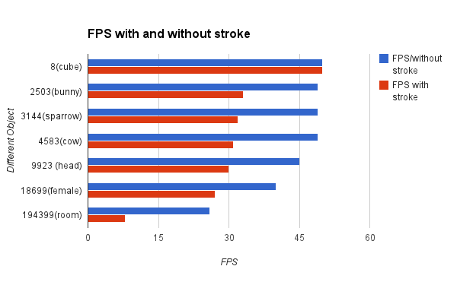
Performance Evaluation

Slide 9
Questions?

